Slide 1
KITCHEN SINK MIGRATION

Slide 2
Agenda
Architecture
Kitchensink Application
Approach Followed for Migration
Kitchensink 2.0
Add-Ons
Assumptions & Learnings
Q & A

Slide 3
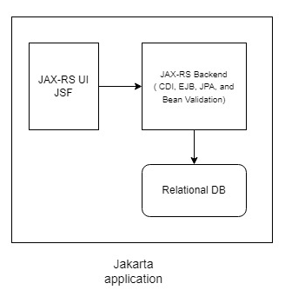
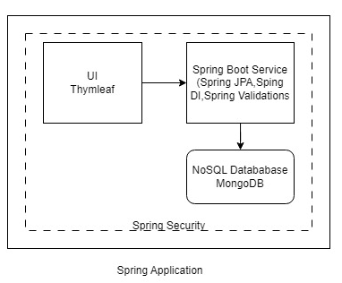
Kitchensink Architecture

Slide 4
Kitchensink Application

Slide 5
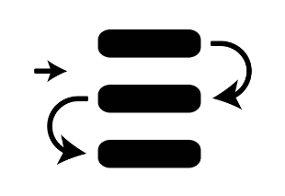




Migration Walkthrough
REST Services
Dependency Injection
Exception Handling
Application Configuration
Security

Slide 6





Migration Walkthrough
Validations
Code Quality
JPA Connectivity
Beans Conversions
User Interface

Slide 7





Relational Database Migration to MongoDB
Existing Schema Analysis
MongoDB
Database Designing
Profiles
Views Promotion
Data Migration

Slide 8
Kitchensink 2.0

Slide 9
Add-Ons
Spring Security
Lombok Addition for Code Quality
MongoDB connectivity
Code Quality with Testing
WAR File Compatibility

Slide 10
Assumptions & Learnings
Vault setup to securely save application credentials
Introduction to JBOSS
Holistic Learning of e2e migration

Slide 11
Q & A
Codebase URL https://github.com/akshay9199/kitchensink-migration

